Slide 1
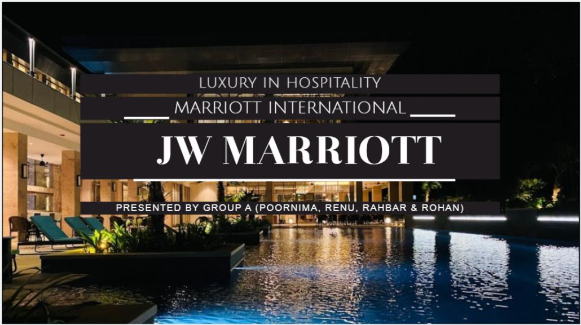

Slide 2
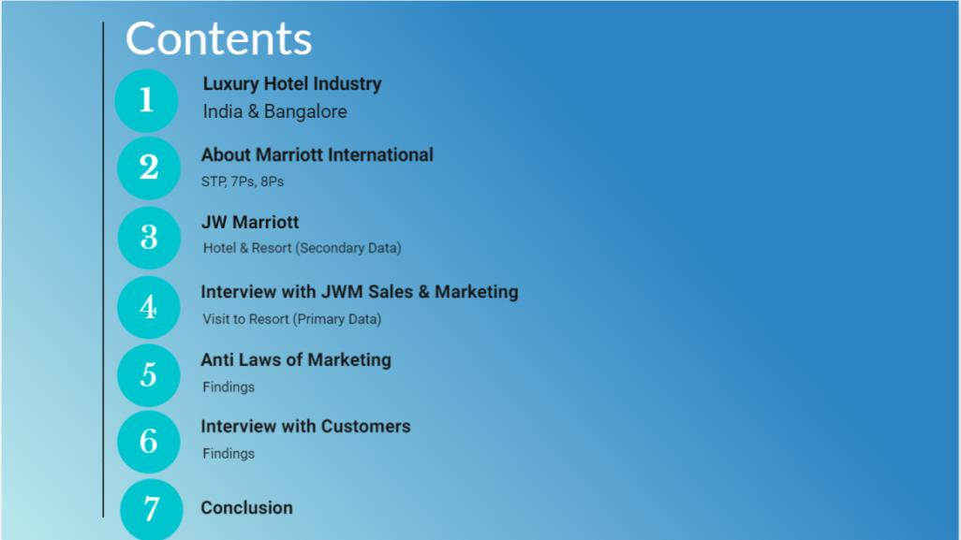

Slide 3
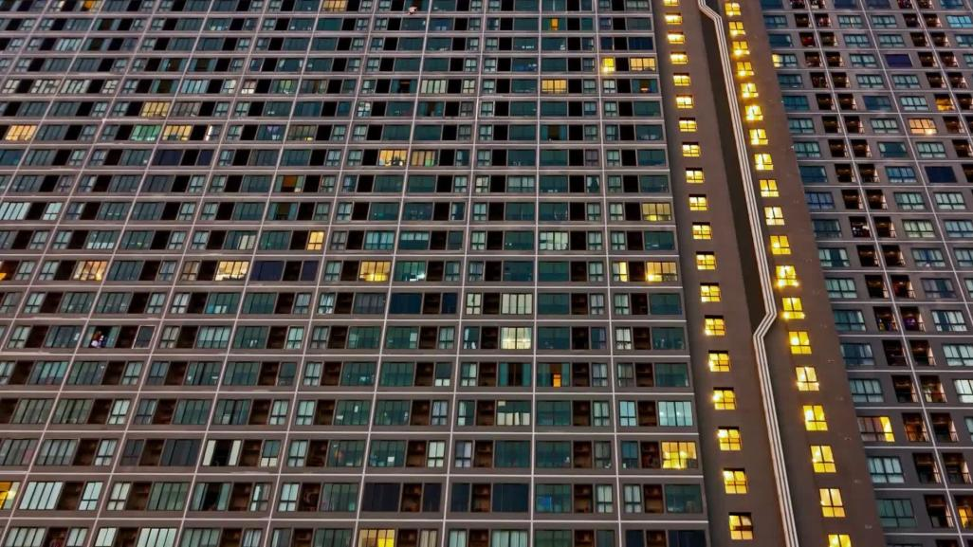
LUXURY HOTEL
A luxury hotel is defined as a hotel that provides a luxurious accommodation experience to the guest.
Luxury hotels typically accommodate high paying guests and the services and dining are expected to be of high quality.
Luxury hotels typically provide various guest amenities such as high-end spa treatments, personal trainers, laundry service and more.

Slide 4
LUXURY HOTEL CUSTOMERS
Affluent people who can afford to spend more on travel.
People who value experiences over material possessions.
People who are willing to pay for quality and luxury.
Travelers on a business expense account.
People celebrating a special occasion.

Slide 5
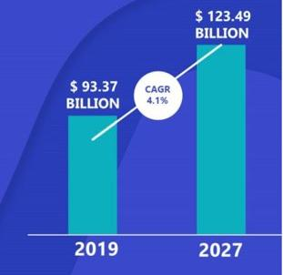
GLOBAL LUXURY HOTEL MARKET
Luxury Hotel Market size was valued at USD 93.37 Billion in 2019 and is projected to reach USD 123.49 Billion by 2027, growing at a CAGR of 4.1% from 2020 to 2027.
Drivers of growth
Increasing disposable income
The rising standard of living
Inclination for leisure travel
Rising tourism and corporate industries
Hosting of sports events by a city or country

Slide 6

INDIAN HOTEL INDUSTRY – ECONOMIC SIGNIFICANCE
India - 10th in world in terms of Travel & Tourism
39 million jobs - 8% of the total employment
Travel Industry - US$ 75 billion in FY20
India Luxury Hotel - US$ 23.69 Billion in 2020
The luxury hotel sector - 11 percent of India’s entire quality hotel supply

Slide 7
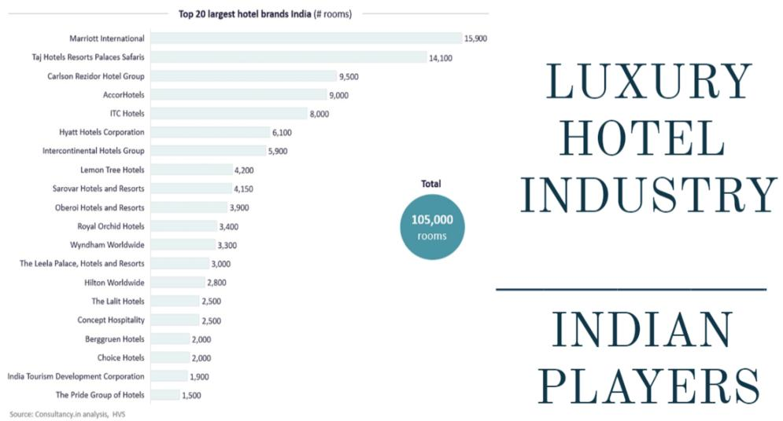

Slide 8
LUXURY HOTEL INDUSTRY, BANGALORE
Other markets in India, it’s about getting RFP (Request for Proposal) program and drive business through relationships
Bangalore Market - High demand and Low supply.
Customers predominantly from IT sector.
Market is more GDS (Global Distribution System) driven than anywhere else in the country
Bangalore is predominantly about technology and GDS

Slide 9
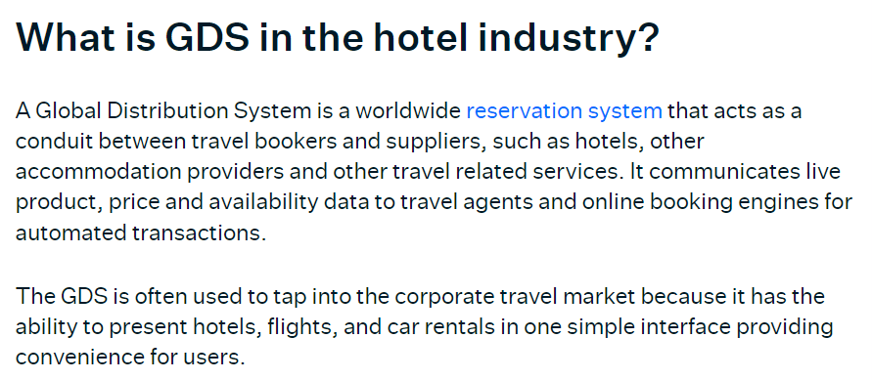
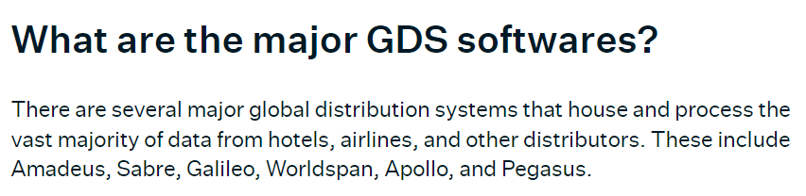
https://www.siteminder.com/r/global-distribution-system/

Slide 10
LUXURY HOTEL INDUSTRY, BANGALORE
In Bengaluru, every Luxury Hotel Brand commands a very different segment, and are all very niche.
Leela has a palatial feel
Taj has huge grounds and the heritage tag
Oberoi is culturally strong
ITC is known for its LEEDS certification
JW Marriott is known for its consistency

Slide 11
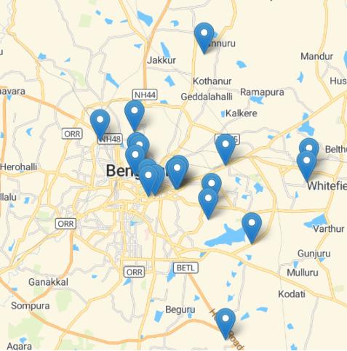
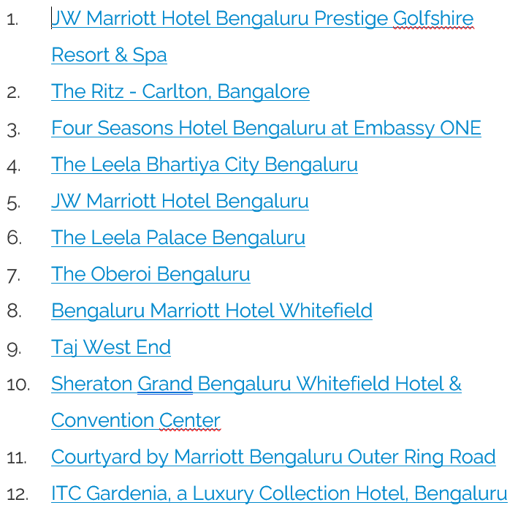

Slide 12
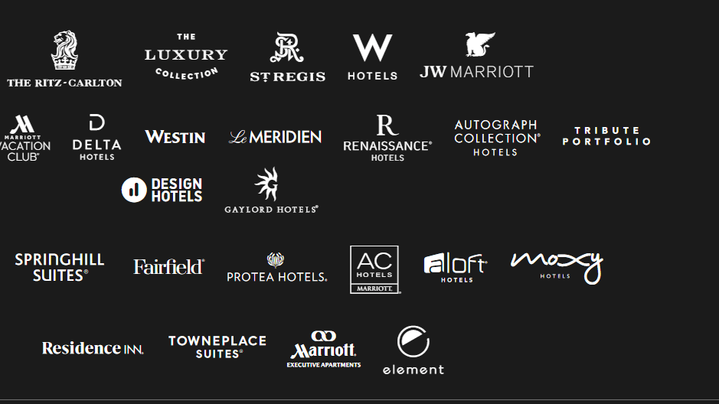
Marriott International
Founded by J. Willard Marriott and his wife Alice Marriott in 1927
American MNC that operates, franchises, and licenses lodging including hotel, residential, and timeshare properties.
Headquartered in Bethesda, Maryland, USA.
30 brands and 8,000+ properties across 139 countries

Slide 13
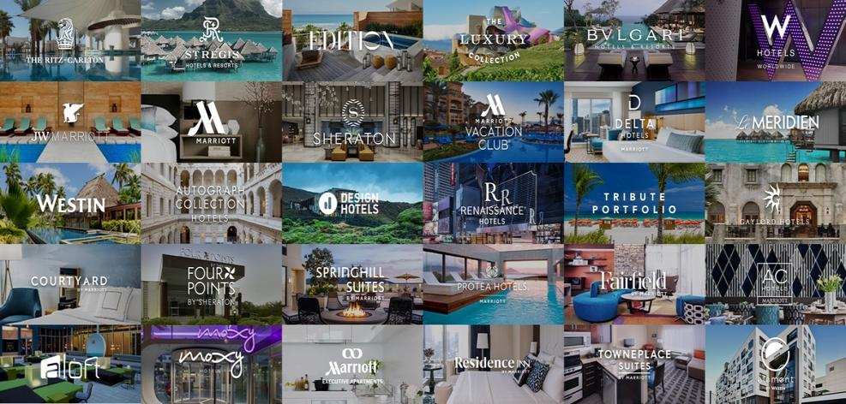

Slide 14
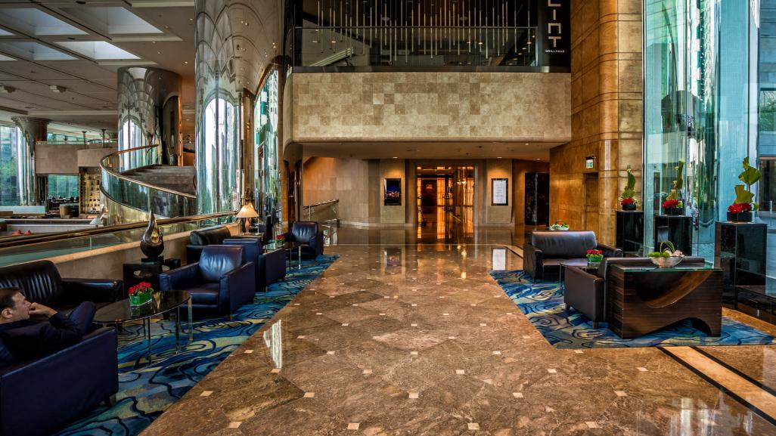
Segments (According to Status)
Luxury (Ritz-Carlton, JW Marriott, Bulgari Hotels & Resorts)
Lifestyle collection (Edition, Autograph Collection, Renaissance, AC Hotels)
Signature (Marriott)
Select service (Courtyard, Fairfield Inn)
Extended stay (Residence Inn, TownePlace Suites) and
Destination entertainment (Gaylord Hotels).
This Photo by Unknown author is licensed under CC BY-NC.

Slide 15
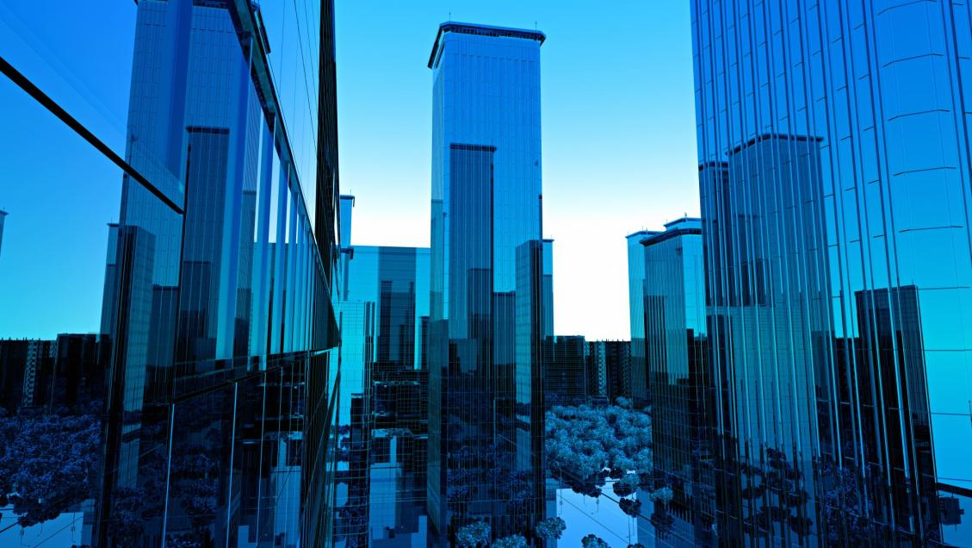
Segments (Geographic)
Hotels representing different brands in various world regions and cities
Luxury hotels like the Ritz-Carlton and JW Marriott are usually located in cities that are characterized by high tourist rates and high levels of household income.

Slide 16
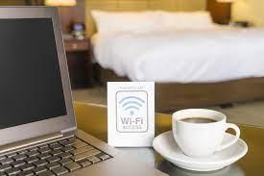
Segments (Psychographic)
Luxury Collection (Exceptional services) - JW Marriott, Ritz-Carlton, and Bulgari Hotels & Resorts. To organise special occasions like weddings or important business meetings.
Lifestyle Collection (Specific interest) - Edition, Autograph Collection, Renaissance, and AC Hotels are unique in terms of their design appealing to travelers with interest in specific lifestyle.
Select Collection (Strictly Business) - Courtyard and Fairfield Inn& Suites, SpringHill Suites, Residence Inn and TownePlace Suites appeals to Businessmen - free Wi-Fi in public spaces, business centers or lobby, PC with internet, printing capabilities

Slide 17
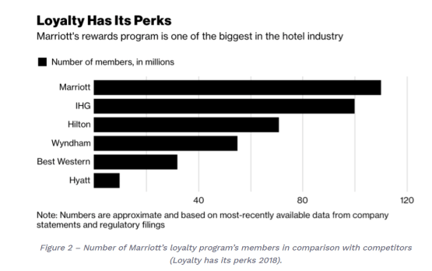
Segments (Behavioural)
The behavioural segmentation is usually realized with references to such factors as the proposed promotions, rewards, and benefits along with the loyalty programmes and proposed schemes of services provision.

Slide 18
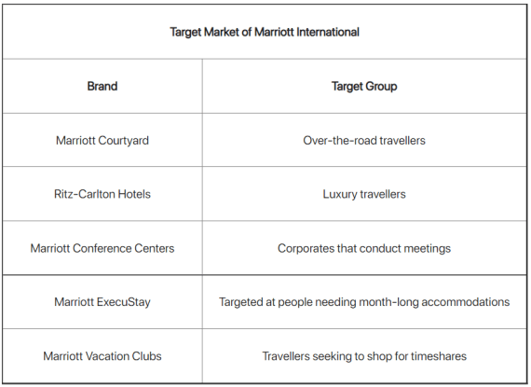
Target Market of Marriott

Slide 19
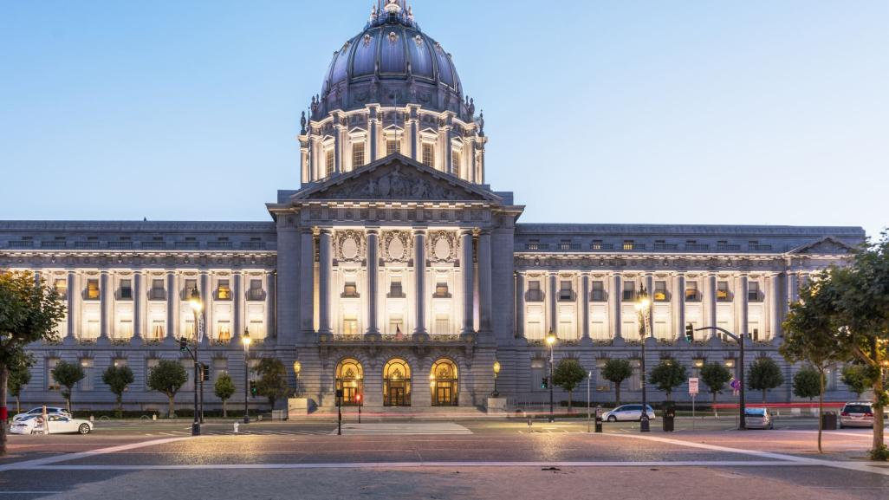
Positioning
Marriott Mission Statement
To enhance the lives of our customers by creating and enabling unsurpassed vacation and leisure experiences.
Marriott Vision Statement
To become the premiere provider and facilitator of leisure & vacation experiences in the world.

Slide 20
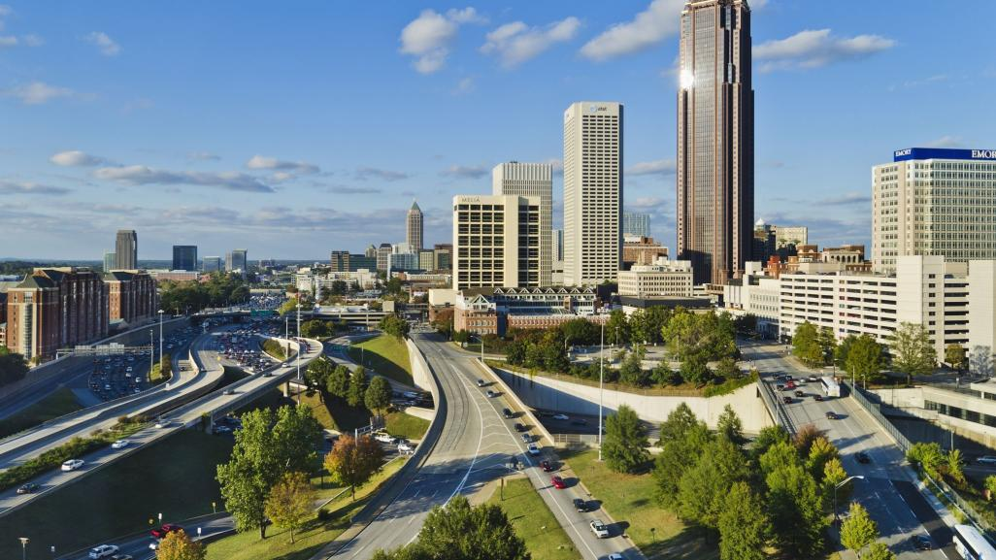
7Ps of Marriott

Slide 21
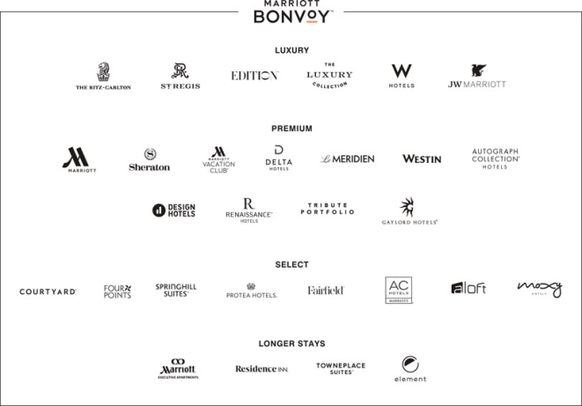
7Ps - Product

Slide 22
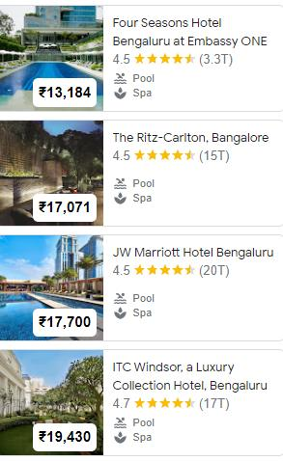
7Ps - Price
In terms of pricing, Marriott International’s price varies with different hotels, customers, and locations
Different hotel brands have been able to maintain differentiated value propositions in terms of their brand promise and brand appeal.

Slide 23
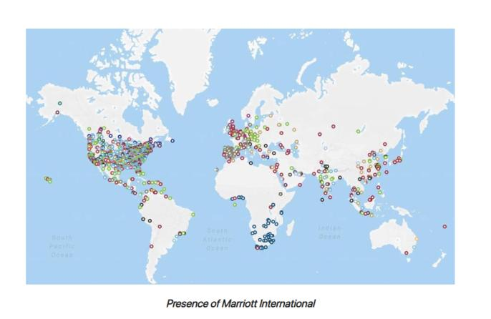
7Ps - Place

Slide 24
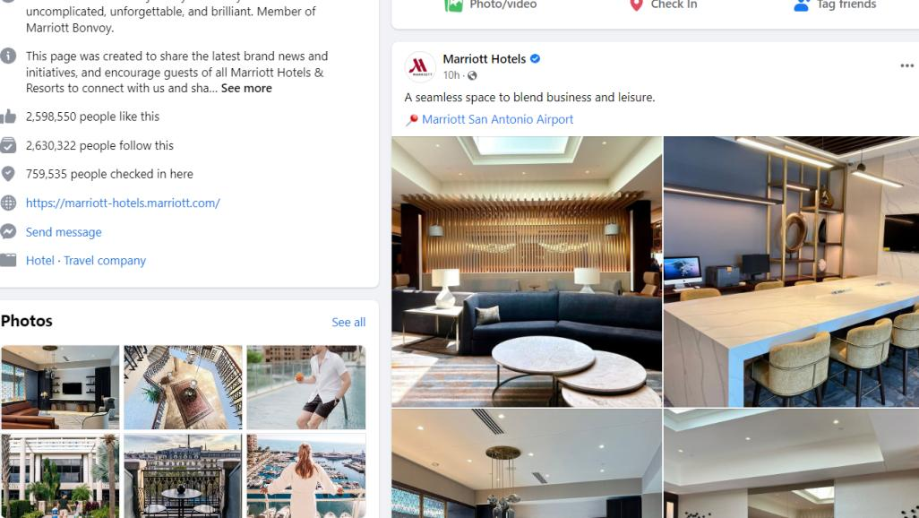
7Ps - Promotion
Digital Channels
Website and App
Reward Programs (Bonvoy Membership)
Facebook and Instagram

Slide 25
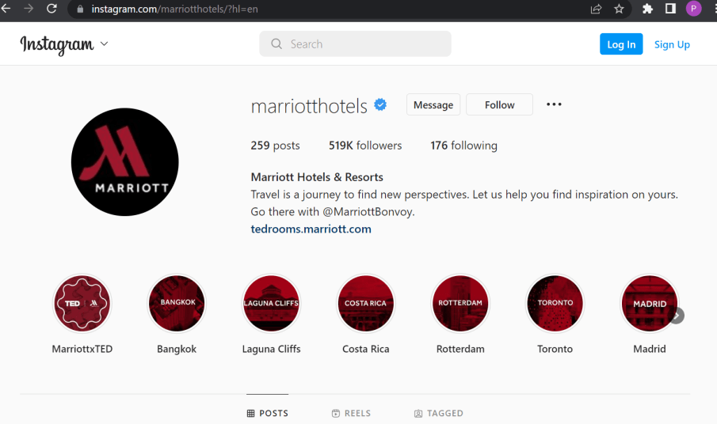

Slide 26
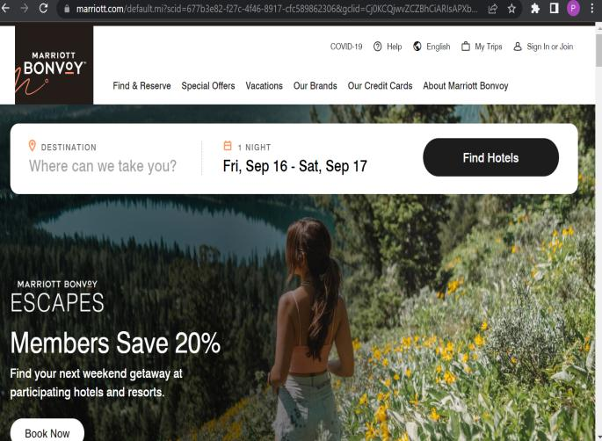
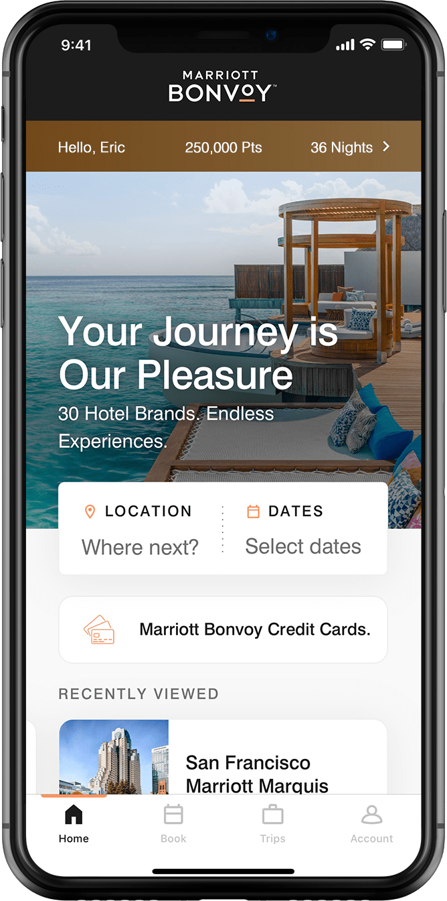

Slide 27
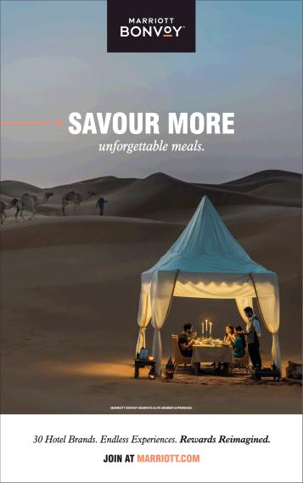
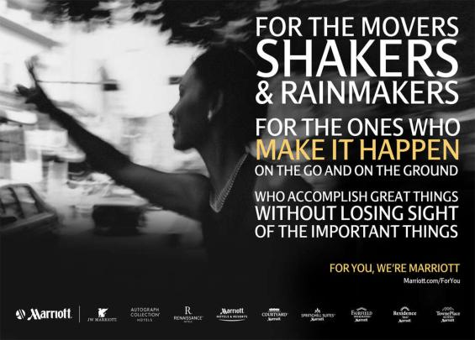
Newspaper Ads

Slide 28
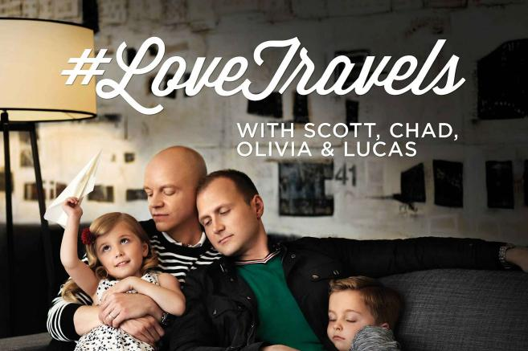
Beyond Barriers - Advocating For Inclusion, Equality, Peace And Human Rights

Slide 29
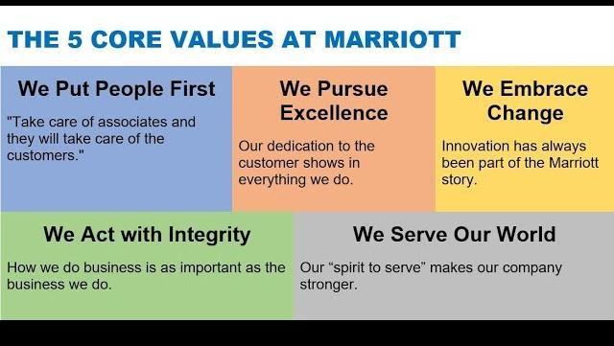
7Ps - People
Pioneers of "If we take care of our Associates, they will take care of our Customers"

Slide 30

7Ps - Process
22 reservation centers run by Marriott.
Online booking websites to book the room.
Check-in from 10.00 and check-out at 12.00 pm policy.
Bonvoy App – Ticket Booking, easy check in, stay and check out.

Slide 31
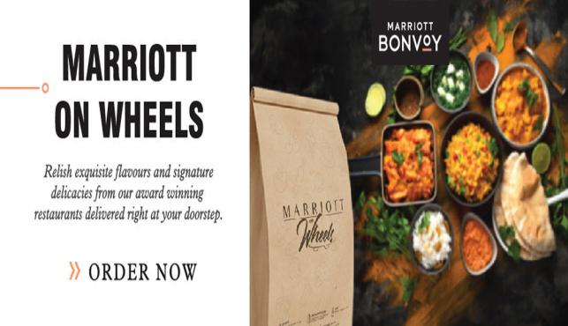
7Ps – Physical Evidence
Partnership with Asset Owners (Franchising)
Luxurious Interiors of International Standards
Branded Amenities
Coveted F&B, Restaurants, Michelin Star Chefs

Slide 32
8Ps of Luxury Marketing by Marriott

Slide 33
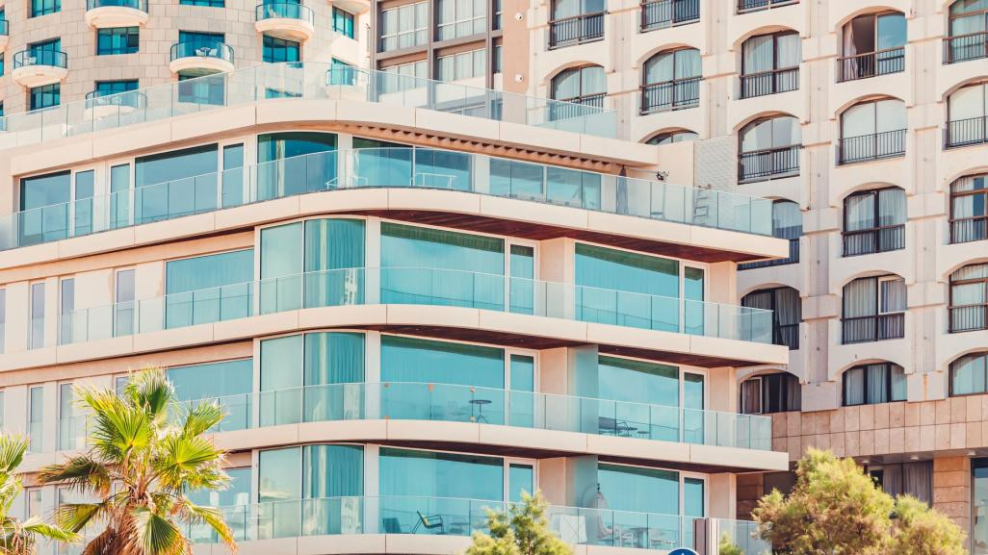
8 Ps of Luxury Marketing
1. Performance
Marriott stands as a symbol of luxury and heritage.
2. Provenance
People choose Marriott not only for its services and customer satisfaction, but they are also influenced by its rich heritage, luxury and brand image associated with their hotels.

Slide 34
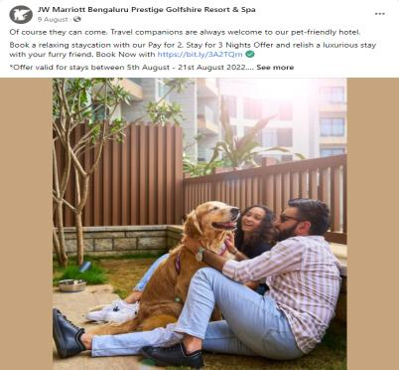
3. Paucity
Marriott creates a sense of paucity by offering services which are scarce such as being pet friendly i.e., allowing pets to be in rooms with customers.

Slide 35
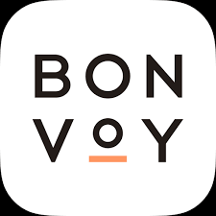
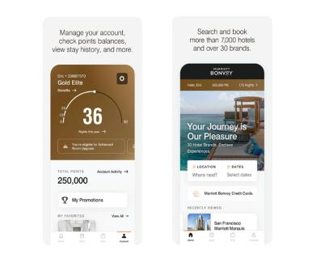
4. Persona
Mariott has an app called Marriott Bonvoy to strengthen brand association by creating a sense of personalization in terms of booking and provides loyalty program through it.

Slide 36
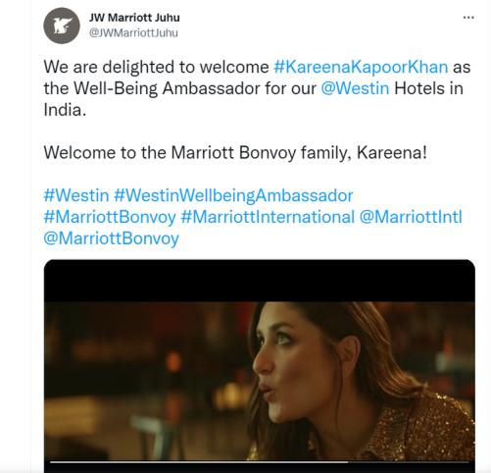
5. Personage
In 2017, JW Marriott Hotels & Resorts announced its partnership with Nora Tobin, the health and wellness leader as the brand's Wellness Ambassador.
In February 2022, Mariott appointed Kareena Kapoor Khan as the Well-Being Ambassador for their Westin hotels in India.
https://mobile.twitter.com/JWMarriottJuhu/status/1491667689512714241

Slide 37
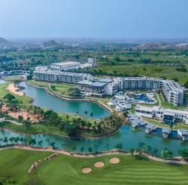
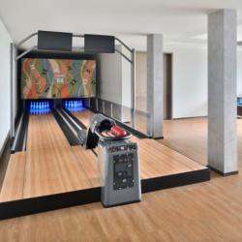
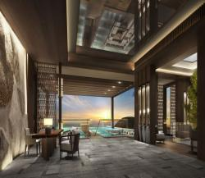
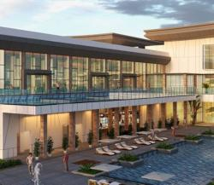
6. Position
Mariott has hotels not only for business purposes but also at remote and peaceful locations for tourists or for enjoying time as leisure. It also has hotels nearer to airports.
JW Marriott Prestige Golfshire at Nandi hills has resort and spa (Staycation).
https://fb.watch/fzMN6xiZJI/

Slide 38
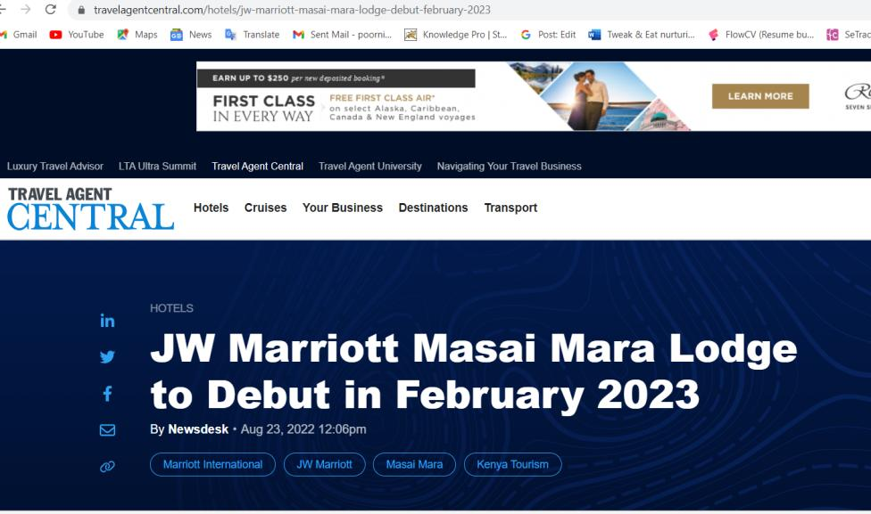
7. Public Relations:
Mariott uses internet and social media for maintaining public relations.

Slide 39
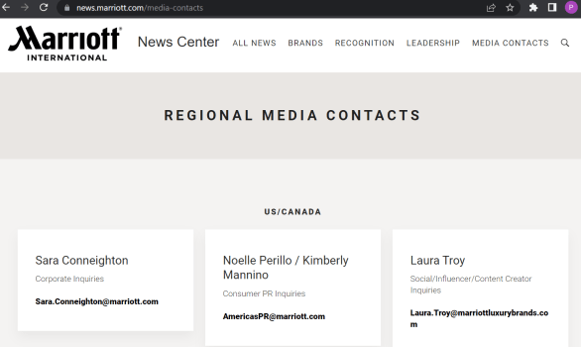
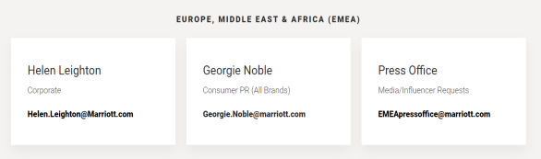
Region wise PR Managers

Slide 40
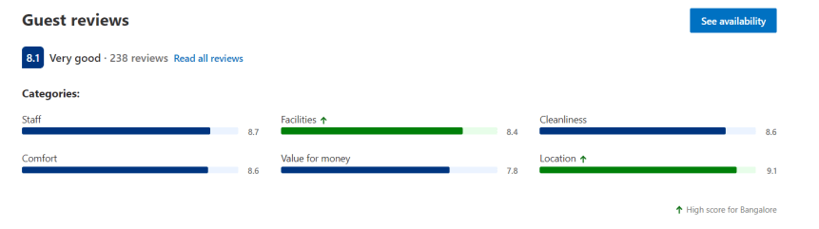
8. Pricing:
Marriott does not compromise with its prices. In contrast, it serves customer expectations in such a way that the customers are willing to pay any premium price for staying in them.

Slide 41
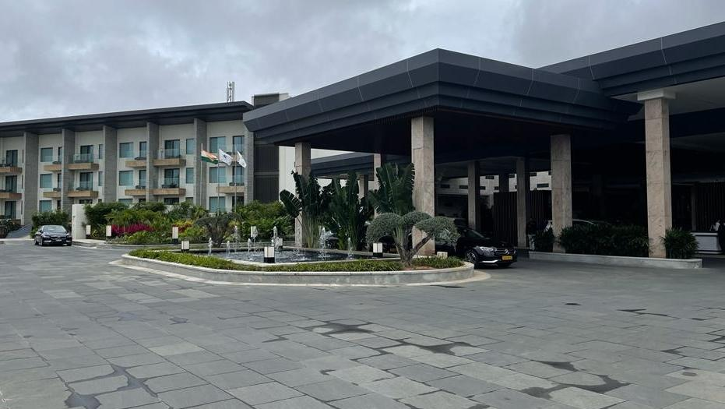
About JW Marriott, Bangalore
One of the Luxury Brands of Marriott
Luxury hotel at the heart of Bangalore, near Cubbon Park, UB City, close to Koramangala and MG Road
Luxury resort near Nandi Hills (Prestige Golfshire Resort)
https://youtube.com/watch?v=OQJPRkdGzNw&feature=share

Slide 42
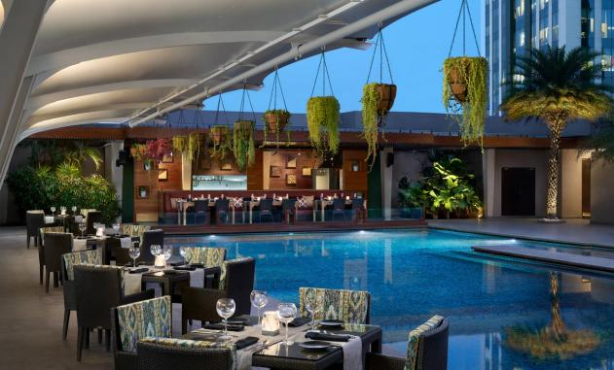
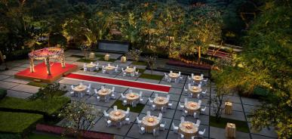
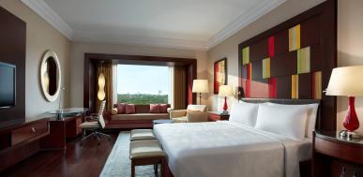
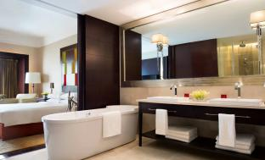
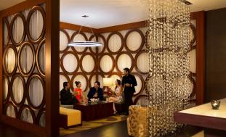
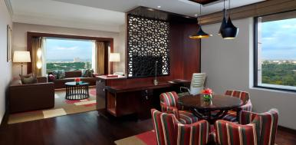

Slide 43

Interview with Director - Sales, JW Marriott Golfshire

Slide 44
Q1 – Working Model of JW Marriott
All the hotels & resorts are partnerships with the builder.
Asset is owned by the builder.
Marriott will manage or franchise the properties
Revenue from Base management fee, franchise fee, licensing fee

Slide 45

Q2. Key Amenities

Slide 46

Q3. Signature Elements
Room Size
Pet Friendly
Wellness Brand
Secret Spots
Bonvoy membership
Airliner Partners (Points to Miles)

Slide 47

Q4. Competitors & Partners
Competitors None
Four Seasons comes close!
No Corporate Loyalty. Some prefer us for "Ease of Doing Business"
Airliner Partners (Points to Miles)
40 airline partners, Marriott points can be transferred to 38 airlines at a 3:1 ratio, and for Air New Zealand and United Airlines, the transfer ratio is 200:1 and 3:1.1, respectively

Slide 48


Slide 49


Slide 50


Slide 51


Slide 52
Q5. Sustainability
No Plastic Bottles/Straws
Bottling Plant
No flowers
Succulents in Lounge/Tables
Solar Power
Organic Waste Converter
No Bin policy
Motion Sensors.
https://youtube.com/watch?v=XRkMbq78l3M&feature=share
https://www.youtube.com/watch?v=jRQmiWFav14

Slide 53
Q6. Any approved Architect/Vendors. How Facility is Managed
No Architect
Designed and executed by Asset Owner
Design just approved by Marriott
Only Management Staff is of Marriott
Rest all (including chef) on payroll of Asset Owner

Slide 54

Q7. Future Plans
Several Projects in Pipeline
Expand to Holiday destinations, aside from business locations

Slide 55


Anti-Laws of Marketing

Slide 56

1. Forget about positioning; luxury is not comparative
According to Ms. Pearl, JW Marriott doesn’t consider anyone as competition.
Its segment and offerings are unique.

Slide 57

2. Does your product have enough flaws to give it soul?
This campaign of Marriott is a message inviting customers who do not travel for mere luxury but to do things they have a passion for.

Slide 58

3. Protect clients from non-clients, the big from the small
Marriott offers Bonvoy Membership exclusively for Marriott Clients restricting offers and benefits only for member clients

Slide 59

4. The role of advertising is not to sell

Slide 60

Magazine Ads

Slide 61

Newspaper Ads

Slide 62

Google Ad

Slide 63

5. Communicate to those whom you are not targeting.
Marriott partnered with Snapchat influencers to make Snapisodes
Like TV travel documentaries.
Influencers showcased Marriott’s new and luxury properties.
It reaches out of Snapchat to YouTube, Facebook sharing, and other channels to capture the attention of other demographics.

Slide 64

6. Luxury sets the price; price does not set luxury

Slide 65
7. Keep Stars out of Advertising
According to Ms. Pearl, JW Marriott does not make paid celebrity endorsements/influencer content

Slide 66

8. Cultivate closeness to the arts for the initiate
JW Marriott Bengaluru partnered with Asian Art House and launched art showcase event called Horizons.

Slide 67

“Summer Hues” in 2018 showcasing Vietnamese and Indian Art.

Slide 68

Wedding Expo

Slide 69
9. Do Not Sell
All the promotions of JW Marriott focus on highlighting the luxurious experience and do not persuade to sell.
They try to elevate the experience every time by increasing their value proposition, their brand image and try to attract customers rather than selling.

Slide 70

10. Keep Non-enthusiasts out
The Marriott Bonvoy promotions target Bonvoy Members exclusively.
Below Ads show various campaigns targeted and offered exclusively to Bonvoy members keeping non-enthusiasts out.

Slide 71



Slide 72

Customer Perspective

Slide 73
Customers Perspective
Questions | Customer 1 | Customer 2 | Customer 3
Type of Traveller | Business | Vacation/Personal | Business/Personal
Why JW Marriott | Booked by my company for corporate event. | Wanted to spend weekend with Family. To celebrate my kid's birthday. | Platinum Bonvoy member. I travel a lot for business.
What Impresses most about JW Marriott | Spacious & brand new, Amenities, Food | Beautiful view, Courteous staff, Great Food | F&B, Bar. Generally love all Marriott brands. Find Courtyard better.

Slide 74
Customer's Perspective
Questions | Customer 1 | Customer 2 | Customer 3
Comparison with Competitors (ITC/Taj/Leela/Four Seasons/Oberoi) | ITC better than JW Marriott in terms of Customer Attention. Taj not as good as Oberoi/ITC/Marriott. Never been to Four Seasons. | ITC & Taj are too Indian. Marriott gives the right international feel. Never been to Four Seasons/Oberoi. | Four Seasons and Marriott are at par. I mostly visit Marriott's business brands.
Suggestions/Grievances | Nothing as such | First Birthday Celebration in JW Marriott. Loved every bit of it. Thanks to the service team. | Don’t get the same experience in all Marriott brands which is a let down.
Would they recommend to friends/family | Maybe | Yes. Very much. | Sure.

Slide 75
Conclusion
Understood Marriott's STP, 7Ps, 8Ps of Luxury Marketing
How JW Marriott positions itself, its Promotion Strategy and Partnerships
How JW Marriott follows Anti-Laws of Marketing
How Customers perceive JW Marriott

Slide 76

References
https://ivypanda.com/essays/marriott-hotels-resorts-market-segmentation-analysis/
https://studycorgi.com/marriotts-market-segmentation-and-positioning/
https://www.notesmatic.com/marriott-international-marketing-mix/
https://iide.co/case-studies/marketing-strategy-marriott-international/
https://www.mbaskool.com/marketing-mix/services/17317-marriott.html
https://idoc.pub/download/j-w-marriott-report-on-7ps-in-marketing-546gy1wk57n8
https://mobile.twitter.com/JWMarriottJuhu/status/1491667689512714241
https://www.magrinopr.com/pr-case-studies/digital-social-public-relations/jw-marriott-nashville/
https://www.comparably.com/companies/marriott/mission
https://www.mordorintelligence.com/industry-reports/india-luxury-hotel-market
https://luxuryhotel.guru/bangalore-city/
https://www.maximizemarketresearch.com/market-report/india-luxury-hotel-market/127656/#:~:text=India%20Luxury%20Hotel%20Market%20was,in%202027.
https://www.linkedin.com/pulse/24-anti-laws-marketing-must-read-luxury-strategy-article-rahul-dutta/
https://seekingalpha.com/article/4349472-marriott-prices-dont-reflect-long-road-to-recovery
https://www.verifiedmarketresearch.com/product/global-luxury-hotel-market-size-and-forecast-to-2025/#:~:text=Luxury%20Hotel%20Market%20size%20was,4.1%25%20from%202020%20to%202027.
https://www.siteminder.com/r/global-distribution-system/

